Slide 1
Input and Interaction
Ed Angel
Professor of Computer Science, Electrical and Computer Engineering, and Media Arts
University of New Mexico
Angel: Interactive Computer Graphics 5E © Addison-Wesley 2009

Slide 2
Objectives
Introduce the basic input devices
  Physical Devices
  Logical Devices
  Input Modes
Event-driven input
Introduce double buffering for smooth animations
Programming event input with GLUT
Angel: Interactive Computer Graphics 5E © Addison-Wesley 2009

Slide 3
Project Sketchpad
Ivan Sutherland (MIT 1963) established the basic interactive paradigm that characterizes interactive computer graphics:
  User sees an object on the display
  User points to (picks) the object with an input device (light pen, mouse, trackball)
  Object changes (moves, rotates, morphs)
  Repeat
Angel: Interactive Computer Graphics 5E © Addison-Wesley 2009

Slide 4
Graphical Input
Devices can be described either by
  Physical properties
    Mouse
    Keyboard
    Trackball
  Logical Properties
    What is returned to program via API
      A position
      An object identifier
Modes
  How and when input is obtained
    Request or event
Angel: Interactive Computer Graphics 5E © Addison-Wesley 2009

Slide 5
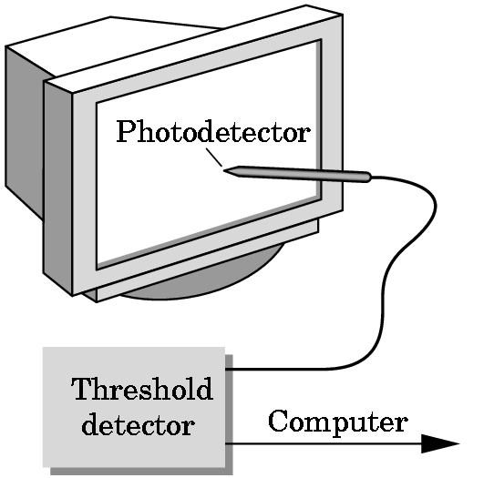
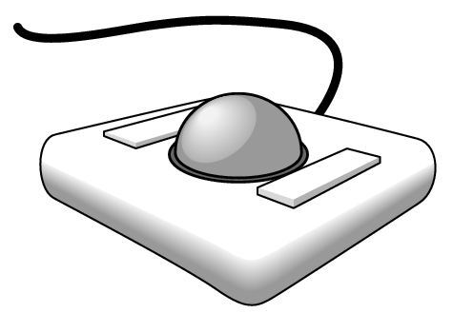
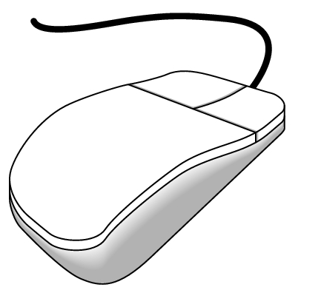
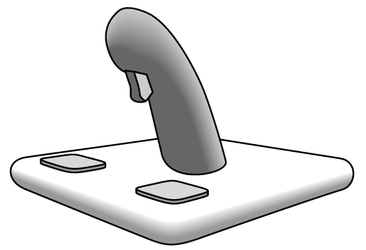

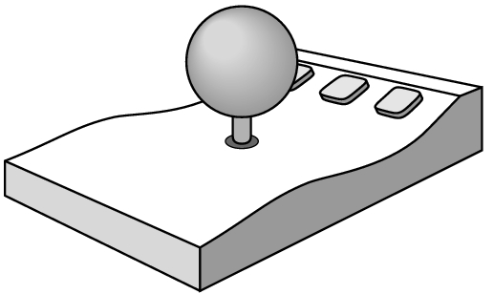
Physical Devices
mouse
trackball
light pen
data tablet
joy stick
space ball
Angel: Interactive Computer Graphics 5E © Addison-Wesley 2009

Slide 6
Incremental (Relative) Devices
Devices such as the data tablet return a position directly to the operating system
Devices such as the mouse, trackball, and joy stick return incremental inputs (or velocities) to the operating system
  Must integrate these inputs to obtain an absolute position
    Rotation of cylinders in mouse
    Roll of trackball
    Difficult to obtain absolute position
    Can get variable sensitivity
Angel: Interactive Computer Graphics 5E © Addison-Wesley 2009

Slide 7
Logical Devices
Consider the C and C++ code
  C++: cin >> x;
  C: scanf (“%d”, &x);
What is the input device?
  Can’t tell from the code
  Could be keyboard, file, output from another program
The code provides logical input
  A number (an int) is returned to the program regardless of the physical device
Angel: Interactive Computer Graphics 5E © Addison-Wesley 2009

Slide 8
Graphical Logical Devices
Graphical input is more varied than input to standard programs which is usually numbers, characters, or bits
Two older APIs (GKS, PHIGS) defined six types of logical input
  Locator: return a position
  Pick: return ID of an object
  Keyboard: return strings of characters
  Stroke: return array of positions
  Valuator: return floating point number
  Choice: return one of n items
Angel: Interactive Computer Graphics 5E © Addison-Wesley 2009

Slide 9
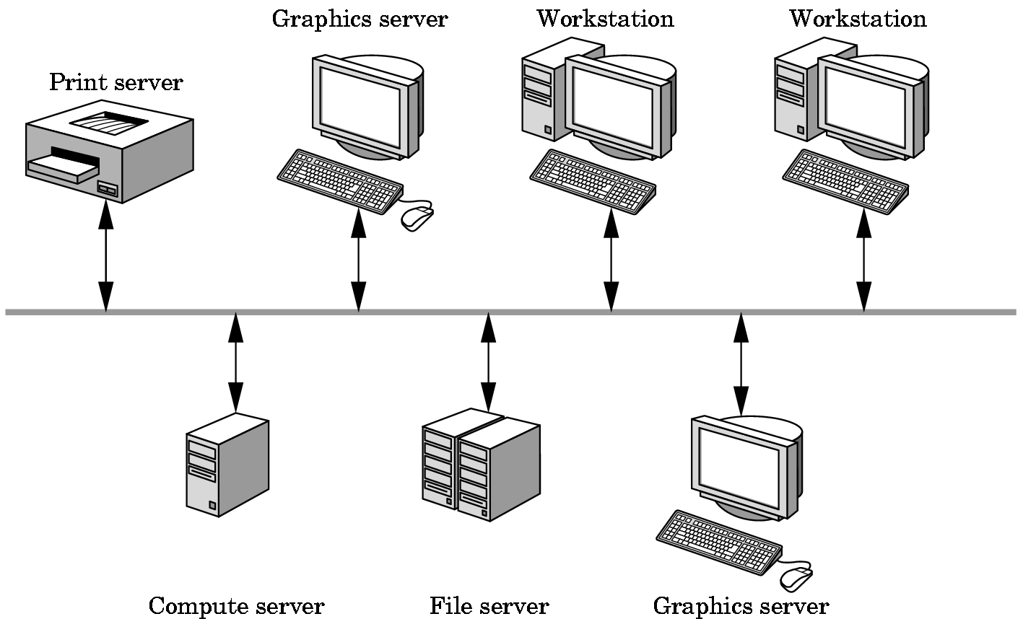
X Window Input
The X Window System introduced a client-server model for a network of workstations
  Client: OpenGL program
  Graphics Server: bitmap display with a pointing device and a keyboard
Angel: Interactive Computer Graphics 5E © Addison-Wesley 2009

Slide 10
Input Modes
Input devices contain a trigger which can be used to send a signal to the operating system
  Button on mouse
  Pressing or releasing a key
When triggered, input devices return information (their measure) to the system
  Mouse returns position information
  Keyboard returns ASCII code
Angel: Interactive Computer Graphics 5E © Addison-Wesley 2009

Slide 11
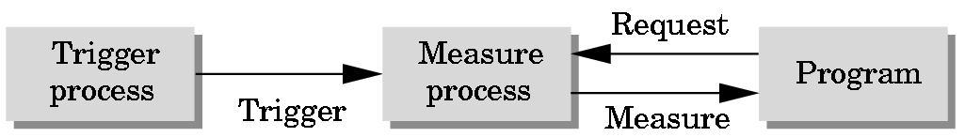
Request Mode
Input provided to program only when user triggers the device
Typical of keyboard input
  Can erase (backspace), edit, correct until enter (return) key (the trigger) is depressed
Angel: Interactive Computer Graphics 5E © Addison-Wesley 2009

Slide 12
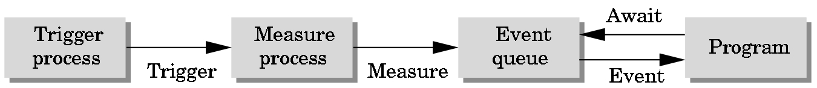
Event Mode
Most systems have more than one input device, each of which can be triggered at an arbitrary time by a user
Each trigger generates an event whose measure is put in an event queue which can be examined by the user program
Angel: Interactive Computer Graphics 5E © Addison-Wesley 2009

Slide 13
Event Types
Window: resize, expose, iconify
Mouse: click one or more buttons
Motion: move mouse
Keyboard: press or release a key
Idle: nonevent
  Define what should be done if no other event is in queue
Angel: Interactive Computer Graphics 5E © Addison-Wesley 2009

Slide 14
Callbacks
Programming interface for event-driven input
Define a callback function for each type of event the graphics system recognizes
This user-supplied function is executed when the event occurs
GLUT example: glutMouseFunc(mymouse)
mouse callback function
Angel: Interactive Computer Graphics 5E © Addison-Wesley 2009

Slide 15
GLUT callbacks
GLUT recognizes a subset of the events recognized by any particular window system (Windows, X, Macintosh)
  glutDisplayFunc
  glutMouseFunc
  glutReshapeFunc
  glutKeyboardFunc
  glutIdleFunc
  glutMotionFunc, glutPassiveMotionFunc
Angel: Interactive Computer Graphics 5E © Addison-Wesley 2009

Slide 16
GLUT Event Loop
Recall that the last line in main.c for a program using GLUT must be
  glutMainLoop();
which puts the program in an infinite event loop
In each pass through the event loop, GLUT
  looks at the events in the queue
  for each event in the queue, GLUT executes the appropriate callback function if one is defined
  if no callback is defined for the event, the event is ignored
Angel: Interactive Computer Graphics 5E © Addison-Wesley 2009

Slide 17
The display callback
The display callback is executed whenever GLUT determines that the window should be refreshed, for example
  When the window is first opened
  When the window is reshaped
  When a window is exposed
  When the user program decides it wants to change the display
In main.c
  glutDisplayFunc(mydisplay) identifies the function to be executed
  Every GLUT program must have a display callback
Angel: Interactive Computer Graphics 5E © Addison-Wesley 2009

Slide 18
Posting redisplays
Many events may invoke the display callback function
  Can lead to multiple executions of the display callback on a single pass through the event loop
We can avoid this problem by instead using
    glutPostRedisplay();
which sets a flag.
GLUT checks to see if the flag is set at the end of the event loop
If set then the display callback function is executed
Angel: Interactive Computer Graphics 5E © Addison-Wesley 2009

Slide 19
Animating a Display
When we redraw the display through the display callback, we usually start by clearing the window
  glClear()
then draw the altered display
Problem: the drawing of information in the frame buffer is decoupled from the display of its contents
  Graphics systems use dual ported memory
Hence we can see partially drawn display
  See the program single_double.c for an example with a rotating cube
Angel: Interactive Computer Graphics 5E © Addison-Wesley 2009

Slide 20
Double Buffering
Instead of one color buffer, we use two
  Front Buffer: one that is displayed but not written to
  Back Buffer: one that is written to but not displayed
Program then requests a double buffer in main.c
  glutInitDisplayMode(GL_RGB | GL_DOUBLE)
  At the end of the display callback buffers are swapped
void mydisplay()
{
glClear(GL_COLOR_BUFFER_BIT|….)
.
/* draw graphics here */
.
glutSwapBuffers()
}
Angel: Interactive Computer Graphics 5E © Addison-Wesley 2009

Slide 21
Using the idle callback
The idle callback is executed whenever there are no events in the event queue
  glutIdleFunc(myidle)
  Useful for animations
void myidle() {
/* change something */
t += dt
glutPostRedisplay();
}
Void mydisplay() {
glClear();
/* draw something that depends on t */
glutSwapBuffers();
}
Angel: Interactive Computer Graphics 5E © Addison-Wesley 2009

Slide 22
Using globals
The form of all GLUT callbacks is fixed
  void mydisplay()
  void mymouse(GLint button, GLint state, GLint x, GLint y)
Must use globals to pass information to callbacks
float t; /*global */
void mydisplay()
{
/* draw something that depends on t
}
Angel: Interactive Computer Graphics 5E © Addison-Wesley 2009

